Slide 1

COMP821 semester 1 2024
Session 3 Cryptography and cryptographic systems Part 2

Slide 2
Orientation
This lecture is about :
Digital signatures
Digital certificates
Key-hashed message authentication codes (HMACs)
Public key encryption for authentication.
Cryptographic systems: VPN, SSL, IPSec
Additional resources: https://www.ncyte.net/resources/cybersecurity-curriculum/interactive-lessons/cryptography/public-key-infrastructure

Slide 3
Stage 4- ongoing communication Message-by-Message Authentication
Threats to ongoing communication
Man-in-the-middle (MITM) attack
Form of attack in which an attacker intercepts messages being sent between two parties and forward them on
Replay attack
Occurs when an attacker intercepts an encrypted message and transmits it again later
Controls – verifying that the supplicant is the person the supplicant claims to be (the true party)
Electronic signature: provides both authentication and message integrity
Two common types : Digital signatures & Key-hashed message authentication codes

Slide 4
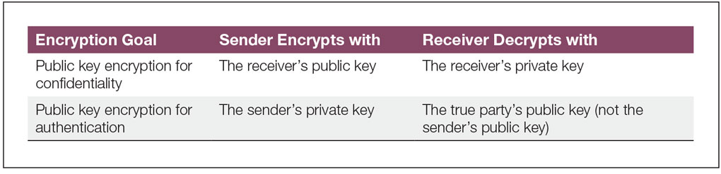
Public Key Encryption for Confidentiality and Authentication
Figure 3-17:
Notes:
Public key encryption is used for both confidentiality and authentication. A frequent source of confusion for students is that public key encryption uses different keys for these two goals. This figure illustrates these differences.

Slide 5
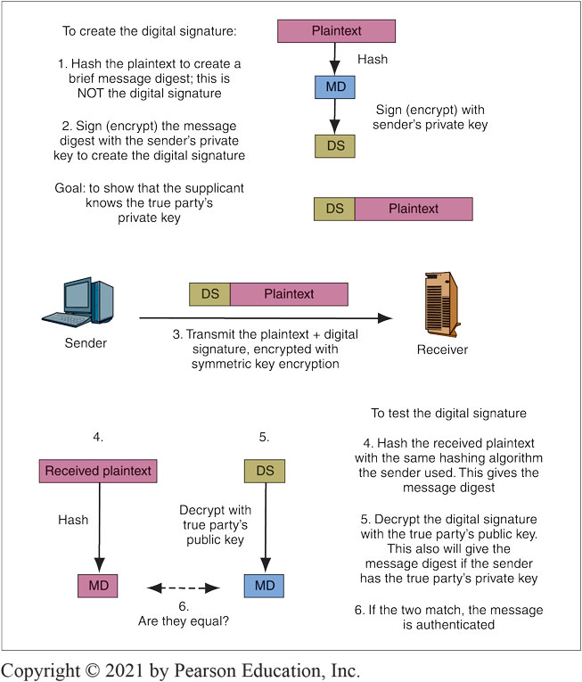
Digital Signature for Message-by-Message Authentication
Figure 3-16
Notes:
This figure shows how to create a digital signature, which authenticates a single message with public key encryption. The process is roughly analogous to the way human signatures authenticate documents.
The first step (1) in creating a digital signature for authentication is to hash the plaintext message. The resulting hash is called the message digest. In the second step (2), the sender encrypts the message digest with the sender’s own private key. Note that the sender used his or her own private key, not the receiver’s public key. This step creates the digital signature. The third step (3) in using a digital signature for authentication is to send the message. In step four (4), the verifier hashes the original plaintext message with the same hashing algorithm the supplicant used. This should produce a message digest. In step five (5), the verification process begins and the receiver first decrypts the digital signature with the true party’s public key, which is widely known. Finally, in step six (6) the message digests are compared.

Slide 6
How to obtain securely the public key?
The verifier cannot trust the sender’s public key if it is sent by the sender themselves . It would always “validate” the sender’s digital signature
The verified normally requires a digital certificate
File provided by a certificate authority (CA)
The certificate authority must be trustworthy
Digital certificate provides the subject’s (True Party’s) name and public key

Slide 7
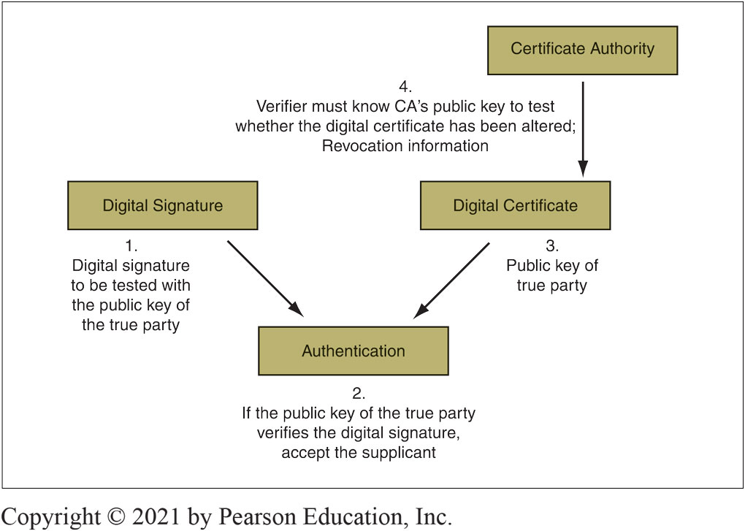
Digital Signature and Digital Certificate for Authentication
Figure 3-21:
Notes:
A digital certificate does not, by itself, authenticate a supplicant. As this figure shows, certificates merely provide the public key of the true party for the verifier to use to make the authentication. Anyone can have the true party’s digital certificate without being the true party, so just having the digital certificate does not authenticate the person or process having the certification.

Slide 8
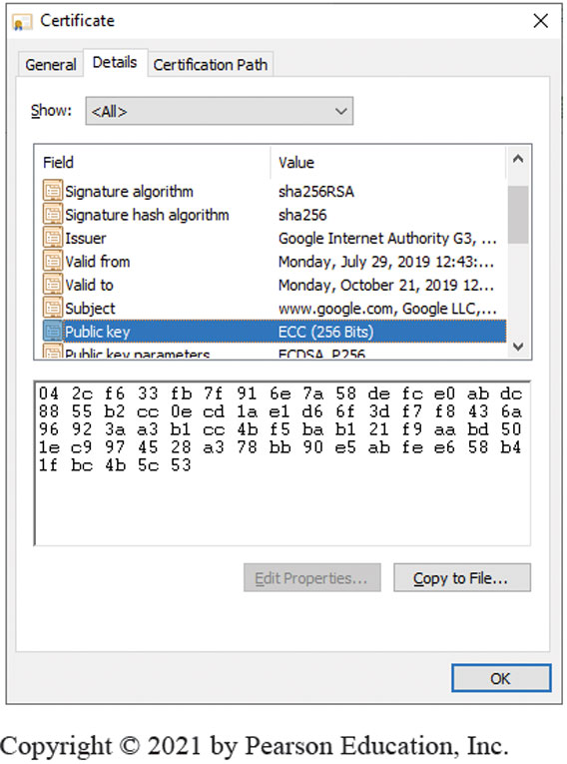
Digital Certificate for Google.com
Figure 3-19:
Notes:
A digital certificate contains a number of fields, which are shown in Figure 3-18. Most importantly, the digital certificate contains the name of the true party (in the Subject field) and the true party’s public key (in the Public Key field as shown in this figure. The verifier looks up the digital certificate of the true party, then uses this public key in the digital certificate to test the digital signature of the supplicant.
How does the verifier know that the digital certificate is legitimate?
First, the verifier must check that the digital certificate is authentic and has not been modified.
Second, each digital certificate has dates before which and after which it is not valid. The receiver must check whether the digital certificate is in its valid period.
Third, even during a digital certificate’s valid period, a CA may revoke a digital certificate, for instance, if there is misbehavior on the part of the certificate subject. Receivers should not accept revoked certificates.
To check for revocation, the verifier can download the certificate authority’s certificate revocation list. If the serial number of the certificate is in the list, then the CA has revoked the digital certificate.

Slide 9
Checking the Digital Certificate
The digital certificate has a digital signature of its own, as it is signed with the Certificate Authority’s (CA’s) private key
It must be tested with the CA’s well-known public key. If the test works, the certificate is authentic and unmodified
The Certificate is valid only during the valid period in the digital certificate. If the current time is not within the valid period, reject the digital certificate
Certificates may be revoked for improper behavior or other reasons therefore revocation must be tested
The received of the certificate (verifier) must check the serial number of the certificate - downloading the CA’s certificate revocation or send a query to the CA (if the CA supports the Online Certificate Status Protocol
https://developer.visa.com/pages/trusted_certifying_authorities
https://www.thesslstore.com/blog/ssl-certificate-still-sha-1-thumbprint/

Slide 10
https://www.thesslstore.com/blog/ssl-certificate-still-sha-1-thumbprint/
A certificate thumbprint is a unique identifier that no other certificate should have.
Since 2015, SHA -1 is not used in SSL, SHA-2 is (SHA256)
The thumbprint and the signature are not y unrelated. In a way, the thumbprint is not actually a part of the certificate. It’s calculated and displayed for your reference

Slide 11
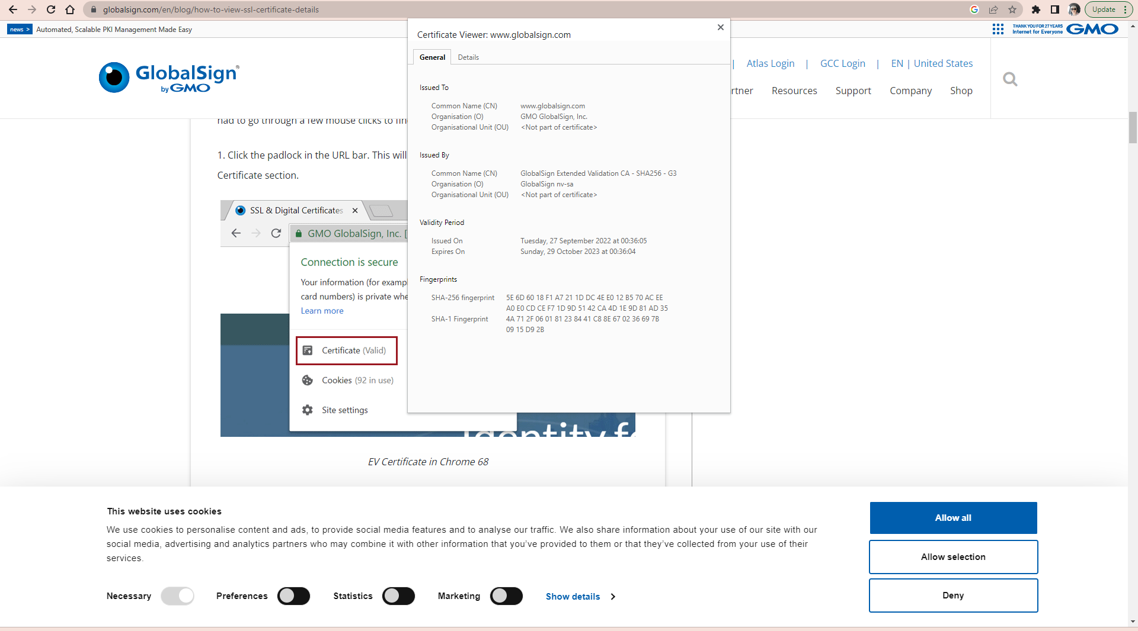

Slide 12
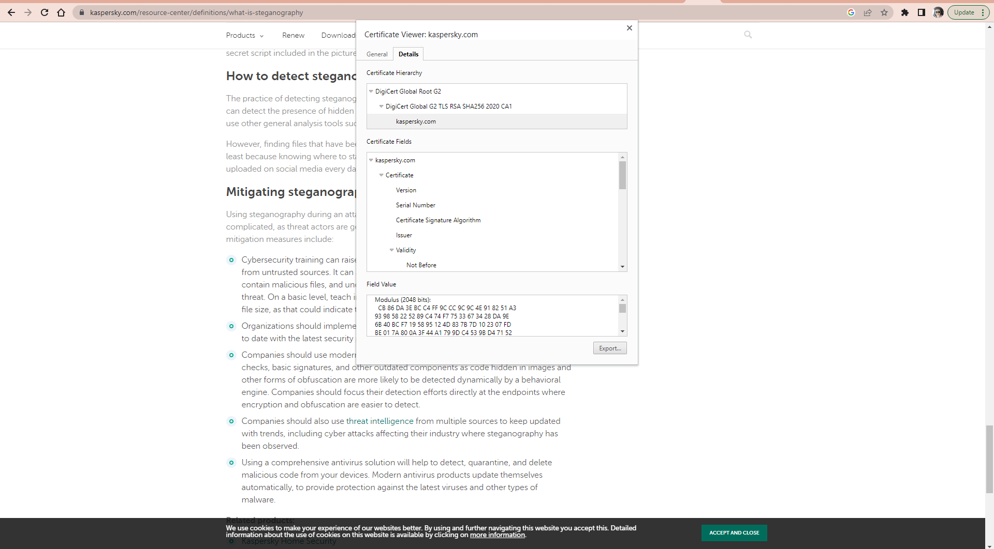

Slide 13
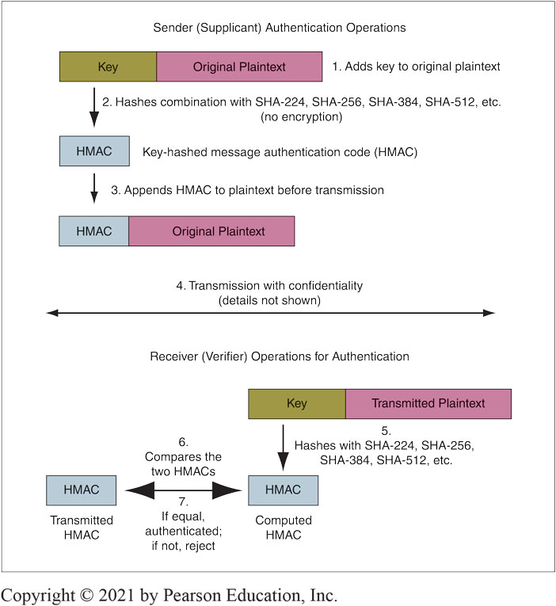
Key-Hashed Message Authentication Code (HMAC)
Notes:
The HMAC uses a key exchanged during the initial negotiation phase. However, it does not use this key for symmetric key encryption. Rather, as this figure shows, the sender adds the key to each outgoing message (1), then hashes the combined message and key (2). This hash is the key-hashed method authentication code (HMAC). The sender adds the HMAC to the message (3) and then encrypts this combined bit stream with symmetric key encryption (4).

Slide 14
HMACs vs Digital Signatures
Both authenticate and , provide a message integrity check
--If the message has been altered, the authentication method will fail automatically
Comparison
Digital signature:
Uses public key encryption for authentication
Very strong but expensive
Key-Hashed Message Authentication Codes
An alternate authentication method using hashing
Much less expensive than digital signature authentication
Much more widely used

Slide 15
Another Security Objective: Nonrepudaition
Nonrepudiation
Means that the sender cannot deny that he or she sent a message
With digital signatures, the sender must use his or her private key
It is difficult to repudiate that you sent something if you use your private key
With HMACs, both parties know the key used to create the HMAC
The sender can repudiate the message, claiming that the receiver created it

Slide 16
Cryptographic Systems

Slide 17
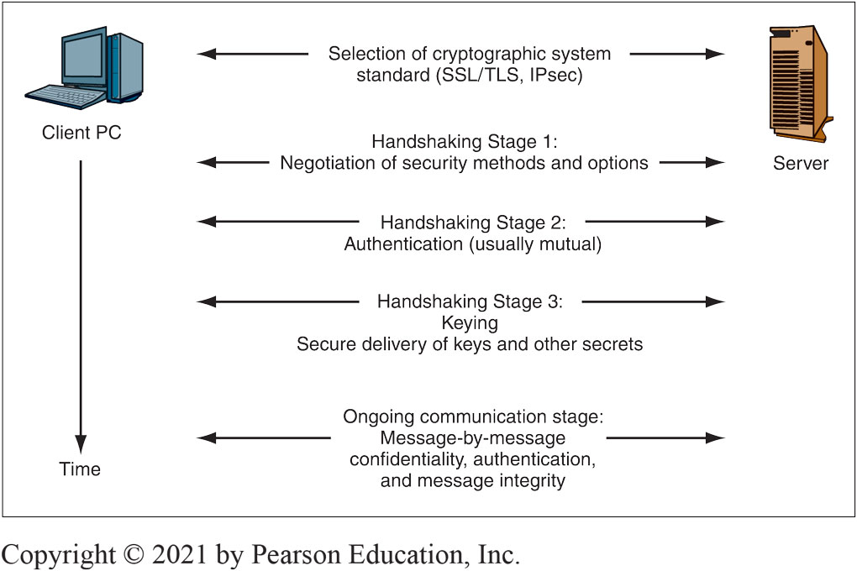
Figure 3-24
the specific cryptographic details
Combine all cryptographic protections, including confidentiality, authentication, and integrity into a single system
Protect user dialogues from attackers and eliminate the need for users to understand the specific cryptographic details
Notes:
The first task in establishing a cryptographic system is selecting a cryptographic system standard for the dialogue. This figure shows that after selecting a cryptographic system standard the remaining handshaking stages are performed.

Slide 18
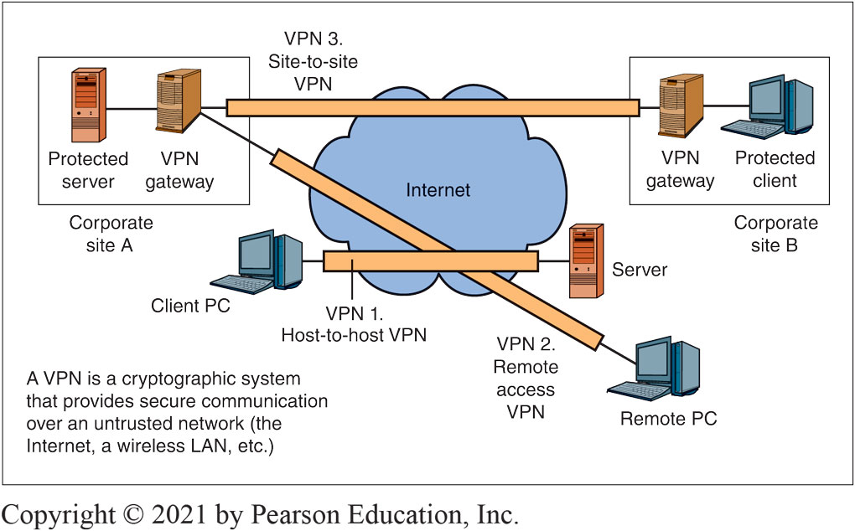
Virtual Private Networks (VPNs)
Figure 3-25:
Notes:
Cryptographic systems are often used over untrusted networks. This figure shows that a virtual private network (VPN) is created by using a cryptographic system to secure communication over an untrusted network (the Internet, a wireless LAN, etc.).individual hosts within the site.
This figure illustrates three types of VPNs. The simplest type is the host-to-host VPN. As exemplified by VPN 1, a host-to-host VPN connects a single client over an untrusted network to a single server.
In turn, a remote access VPN connects a single remote PC over an untrusted network to a site network (see VPN 2).
Finally, site-to-site VPNs (see VPN 3) protect all traffic flowing over an untrusted network between a pair of sites.

Slide 19
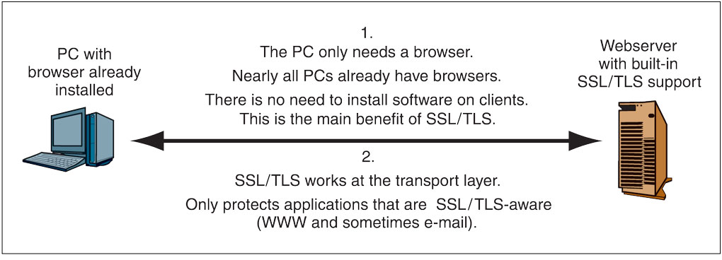
Host-to-Host SSL/TLS VPN
Figure 3-26:
Figure 3-26:
Notes:
When you make a purchase over the Internet, your sensitive traffic is almost always protected by a cryptographic system standard that was originally called Secure Sockets Layer (SSL) when the Netscape Corporation created it. Netscape passed the standardization effort to the Internet Engineering Task Force (IETF), which renamed the standard Transport Layer Security (TLS) to emphasize that it works at the transport layer. We will refer to it asSSL/TLS, but in actual practice, people simply call it SSL or TLS. This figure shows how an SSL/TLS host-to-host VPN operates.

Slide 20
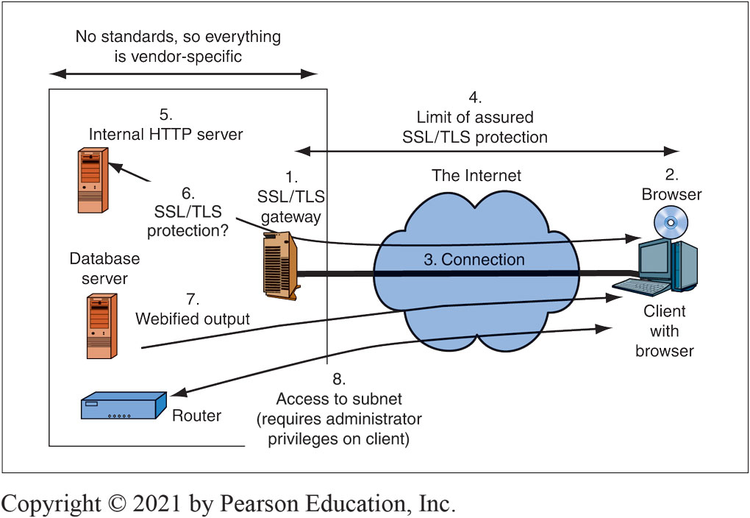
SSL/TLS and Remote Access VPN Using a Gateway
Figure 3-27:
Notes:
As Figure 3-27 shows, to convert SSL/TLS from a host-to-host VPN to a remote access VPN, firms place an SSL/TLS gateway at the border of each site (1). The remote client’s browser (2) establishes a single SSL/TLS connection with the SSL/TLS gateway (3), rather than with
individual hosts within the site.

Slide 21
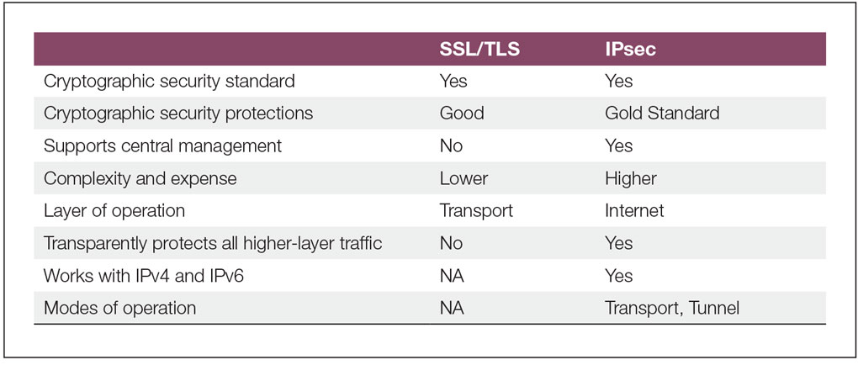
IP Security (IPsec) versus SSL/TLS
Figure 3-28:
Notes:
Figure 3-28 compares IPsec with the SSL/TLS cryptographic security standard. IPsec is more complex and therefore more expensive to introduce than SSL/TLS, but IPsec is the gold standard in VPN security. It offers the strongest protections and supports centralized corporate control over all IPsec operation on all devices.

Slide 22
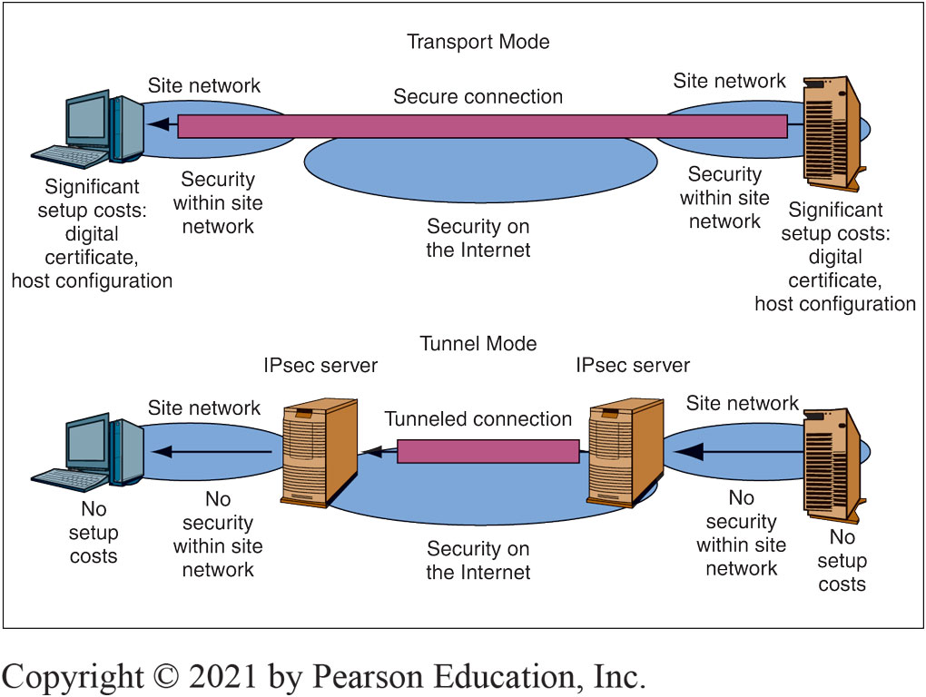
IPsec Operation: Tunnel and Transport Modes
Figure 3-29
Notes:
In IPsec, there are two operating modes: the transport mode and the tunnel mode. Figure 3-29 illustrates how these two modes work. Figure 3-30 compares their characteristics in a table.
M03_

Slide 23
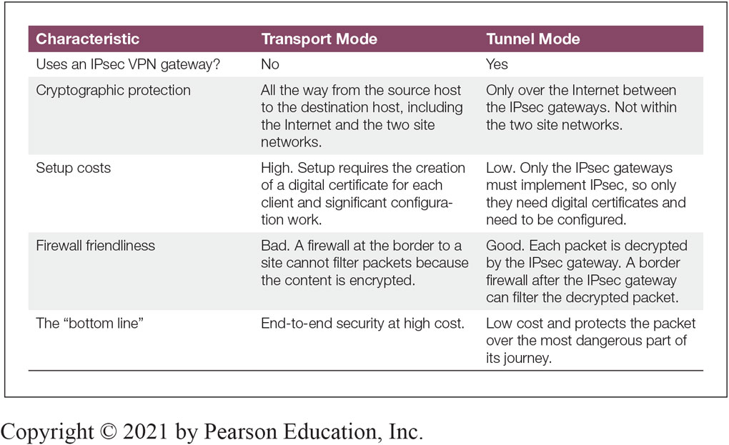
Comparing IPsec Transport and Tunnel Modes
Figure 3-30:

Slide 24
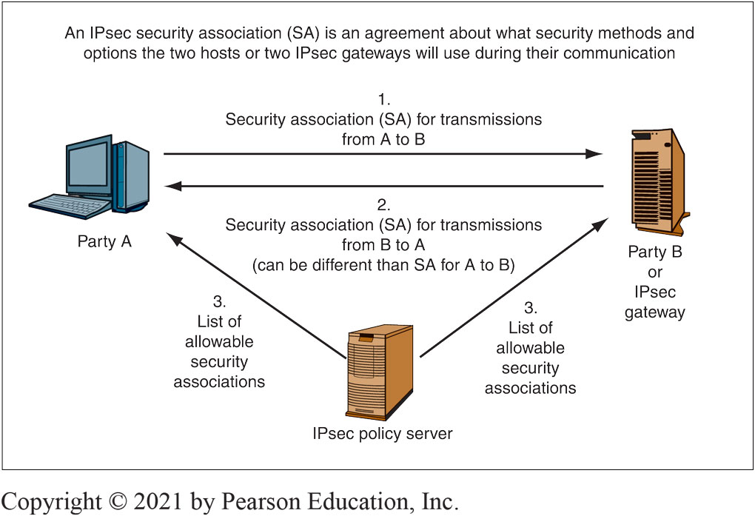
IPsec Security Associations
Figure 3-31
Notes:
Figure 3-31 illustrates how communicating partners negotiate security associations.

Slide 25
Homework: Research Quantum Security
Quantum Mechanics : Describes the behavior of fundamental particles. Complex and even weird results
Quantum Key Distribution
Transmits a very long key—as long as the message
A one-time key that will not be used again
A one-time key as long as a message cannot be cracked by cryptanalysis
If an interceptor reads part of the key in transit, this will be immediately apparent to the sender and receiver
Quantum Key Cracking
Tests many keys simultaneously
If quantum key cracking becomes capable of working on long keys, today’s strong key lengths will offer no protection
You can access the chapter below (use AUT University as the nane of the institution)
https://link.springer.com/chapter/10.1007/978-3-030-63115-4_19

